Slide 1
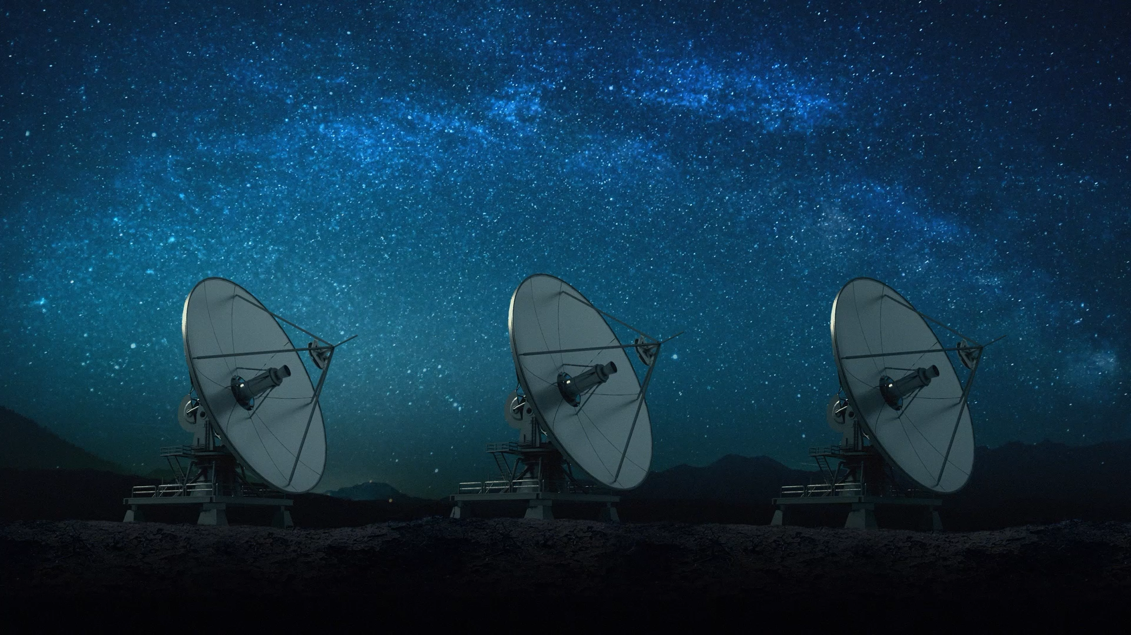
Classification of Celestial Bodies
Matt Foley

Slide 2
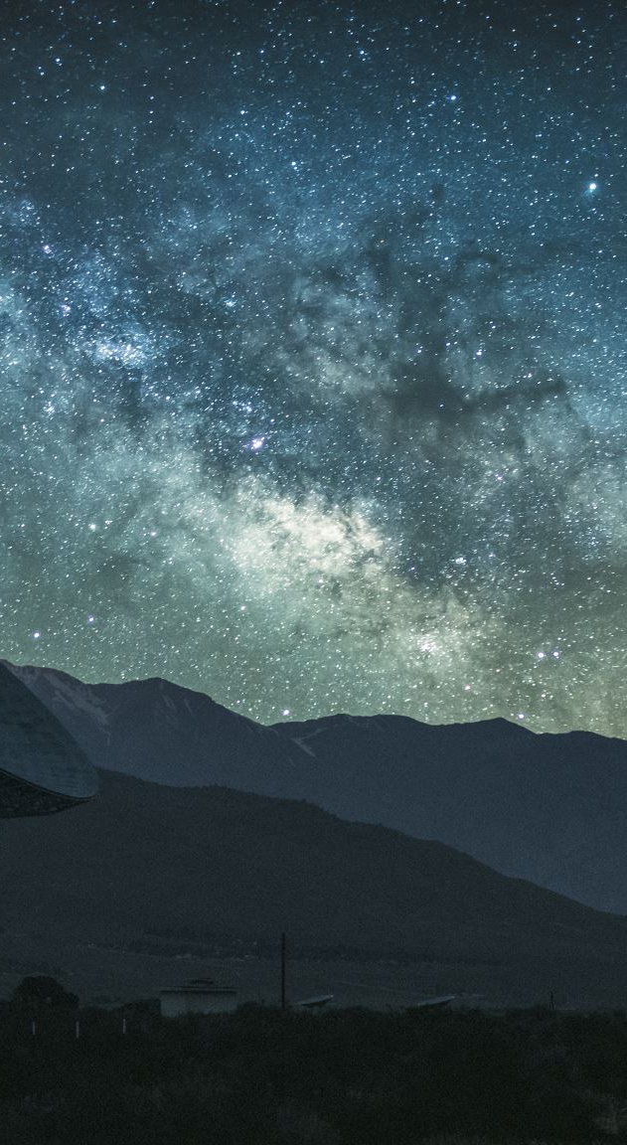
Dataset
The dataset was found on Kaggle, ”Stellar Classification Dataset - SDSS17”
Contains 100,000 samples from Sloan Digital Sky Survey which is an astrological survey being conducted with a large telescope located in New Mexico. The survey has been going on for more than 40 years now and has the goal of mapping out our entire galaxy.
One of the most common problems astronomers run into when conducting surveys like this is analyzing the data a telescope observes about a celestial body (in the form of information about the light waves) and classifying that body.
Today I’ll be showing you how I trained various machine learning models to classify these celestial bodies as either a star, galaxy, or quasar based on this telescope data.

Slide 3
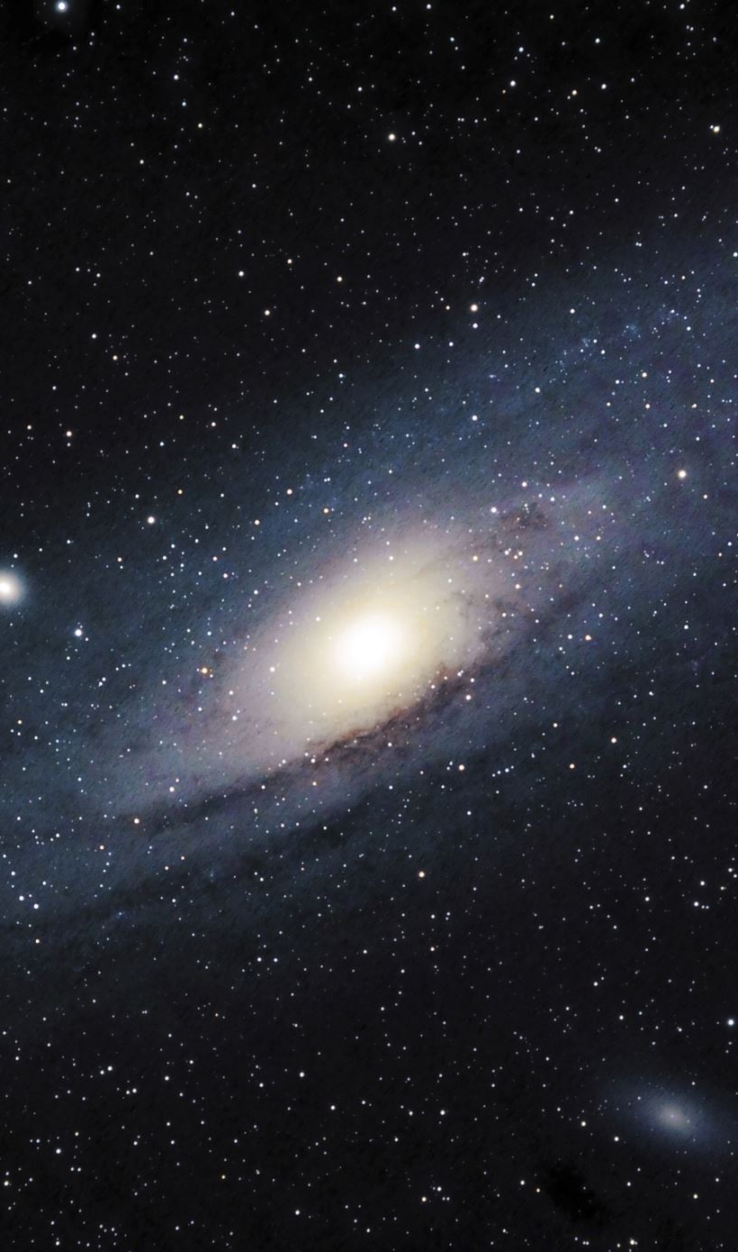
Dataset Feature Overview
The dataset contained a total of 18 features, however most of these were not used while training the models.
One of those features is ”class” which is either a star, galaxy, or quasar. This is what the models will be predicting based on the rest of the data.
Every other feature is some kind of numeric value which makes things a lot easier.

Slide 4
Features that were used
Name | Data Type | Description
u | float | Ultraviolet filter in the photometric system
g | float | Green filter in the photometric system
r | float | Red filter in the photometric system
i | float | Near Infrared filter in the photometric system
z | float | Infrared filter in the photometric system
All these features represent the brightness of the observed light when passed through certain filters in the telescope.
Different celestial objects (galaxies, stars, quasars) have distinct light magnitude distributions in different filters, this is why including these features are vital to having a good model.

Slide 5
Features that were used
Name | Data Type | Description
redshift | float | redshift value based on the increase in wavelength
plate | int | refers to the plate (physical object) used to take this scan
Redshift refers to the stretch in light waves as they travel further, making it a good indicator of both distance and age. This makes a lot of sense to include as a star will be much closer and younger than a quasar or a galaxy, making the class very dependent on this feature
Plate refers to a physical plate used to gather data. Each plate is used to observe a different part of the sky, meaning the plate can be used as a rough indicator to where the body is located

Slide 6
Features that were not used
Name | Data Type | Description
obj_id | int | Unique object id of each observied celestial body
run_id | int | Run Number used to identify the specific scan
rerun_id | int | Rerun Number to specify how the image was processed
cam_col | int | Camera column to identify the scanline within the run
field_id | int | Field number to identify each field
spec_obj_ID | int | Unique ID used for optical spectroscopic objects
fiber_id | int | fiber ID that identifies the fiber that pointed the light at the focal plane in each observation
Everything here is some kind of ID number associated with each entry. They won't be included in the model since they don’t correlate at all with that entry’s class

Slide 7
Features that were not used
Name | Data Type | Description
alpha | float | Right Ascension angle of telescope during observation
delta | float | Declination angle of telescope during ovbservation
MJD | int | Modified Julian Date of observation
Alpha and Delta refer to the angles the telescope was at during observation. Initially I thought this would indicate position of the celestial body, however it doesn’t. Due to the Earth’s rotation two bodies observed at the same angles could be in completely different points in space if not observed at exactly the same time
MJD is a way to express the date of the observation. Again, the class of the body doesn’t depend at all on the date of its observation so it will not be included in the model.

Slide 8
Data Analysis

Slide 9
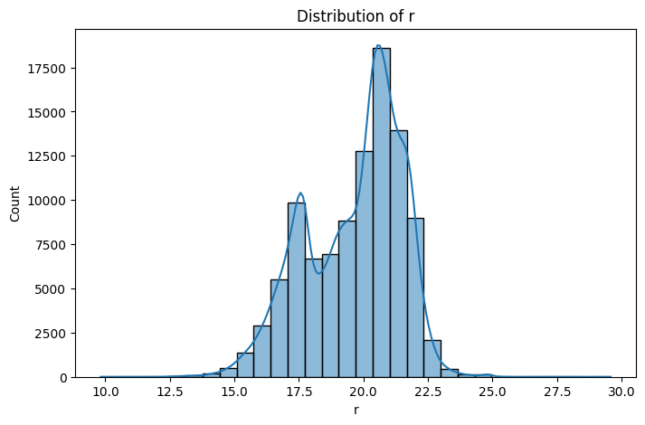
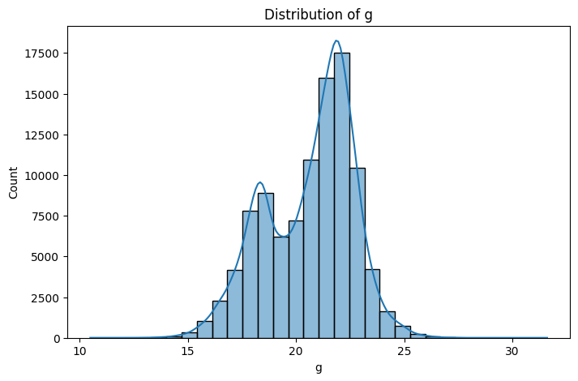
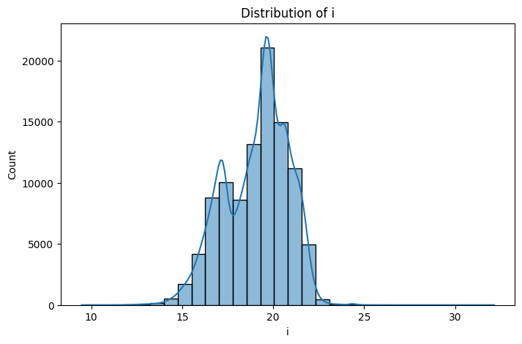
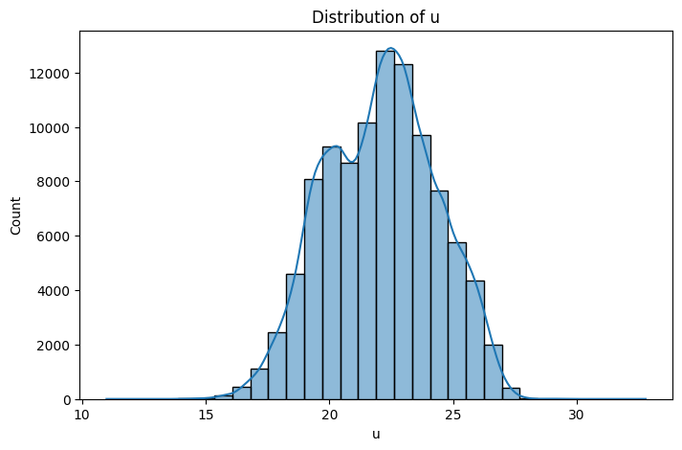
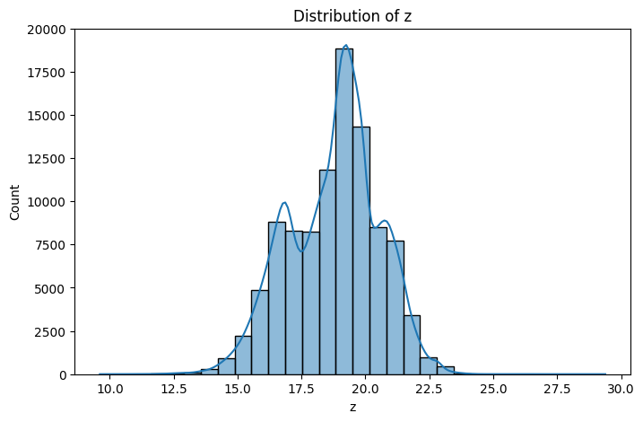
Distribution of each Feature (light filters)
Very uniform distribution for all the different light filters and no outliers which is ideal.
Notes:
All graphs made with the matplotlib in python

Slide 10
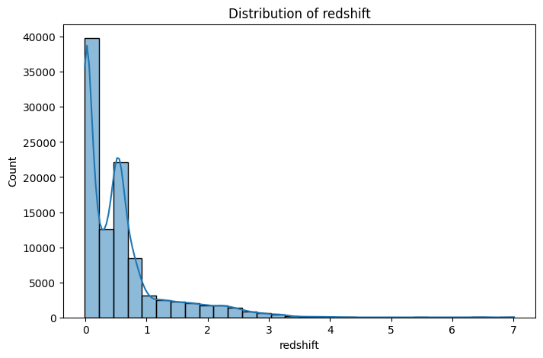
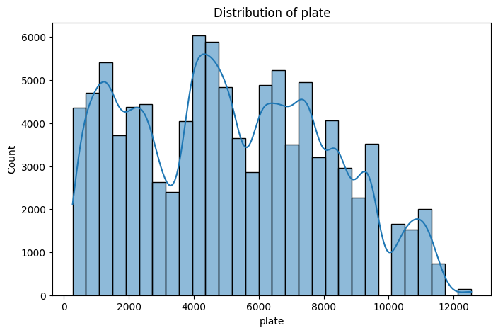
Distribution of each Feature (redshift & plate)
Redshift distribution is heavily skewed towards 0 but does generally decrease going to the right. This indicates a greater presence of closer and younger celestial bodies.
Plate distribution is very spread out. As discussed before plate is a general indicator of location in space meaning the dataset has a pretty good variation of locations looked at.

Slide 11
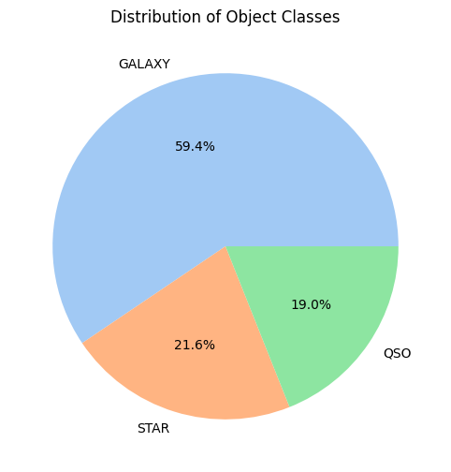
Class Distribution
Classes are not very evenly distributed.
While this distribution isn’t perfect it won't be too much of an issue as star and quasar are represented enough that a model wont just learn to guess galaxy every time.

Slide 12
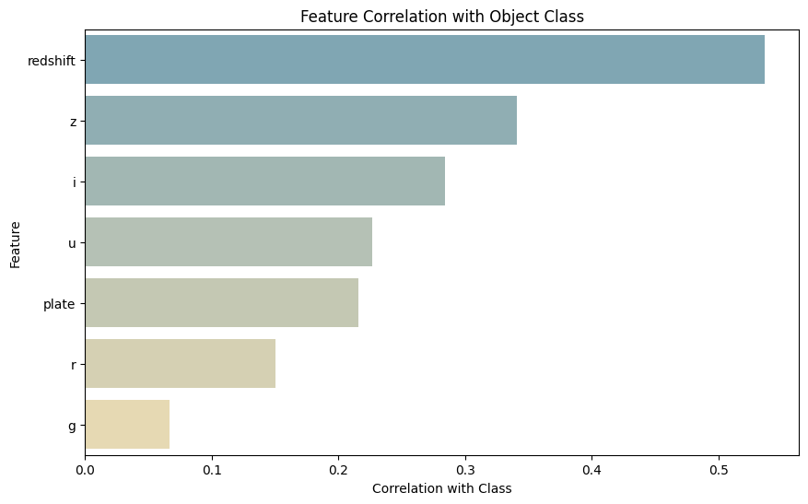
Feature Correlation
Displayed are the Pearson correlations between each feature and the class labels.
We can see that none of our features has a very high correlation with class which is good so no feature will completely dominate the models learning.
We do see that the green and red light filters don’t correlate very well with the class label.
This doesn’t necessarily mean a feature has no correlation with class even if its score is low here.

Slide 13
Choosing and Creating a Model

Slide 14
Need a classification model that can handle large datasets
Random Forest
Good for handling non-linear relationships (good since we don’t have strong correlations)
Scales okay with large datasets
Not as prone to variance as other models
Logistic Regression
Scales very well with large datasets
Naturally resistant to overfitting
Using multinomial logistic regression will give insight into how confident the model is for each class
SVM Classifier
Works well in high dimensional data spaces
Works well when data is linearly separable
Not ideal for large datasets as creating the model could take a lot of time
Notes:
Random forest good at handling non-linear relationships since it doesn’t try and create a classification border like other models
Logistic regression scales so well since the process to make the model isn’t very computationally complex
SVM: Since we only chose the most meaningful features there shouldn’t be a ton of noise which is very good for SVM

Slide 15
Creating the Models
Used an 80%-20% ratio when splitting the data into training and testing groups
Used random_state parameter in the sklearn library’s train_test_split function so I could specify a seed for the random split to use.
This is important when comparing models to each other that way you know you are training each one on the exact same data.
Training and testing data were stratified so they share the same distribution of class features.
All the models were created using the scikit-learn library.

Slide 16
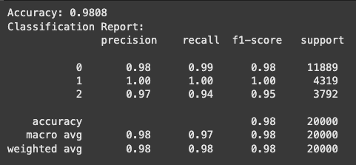
Random Forest Results
Class 0: Galaxy
Class 1: Star
Class 2: Quasar
Model preformed extremely well, was able to predict stars with 100% accuracy and had 98% accuracy overall.

Slide 17
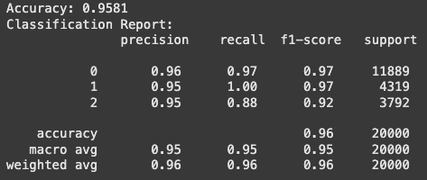
Logistic Regression Results
Class 0: Galaxy
Class 1: Star
Class 2: Quasar
Didn’t preform quite as well as random forest but still very good, 95% accuracy isn’t bad at all.

Slide 18
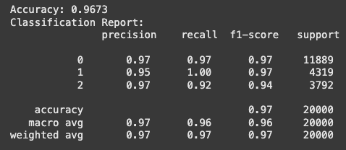
SVM Classifier Results
Class 0: Galaxy
Class 1: Star
Class 2: Quasar
The model preformed very well, not quite as good as the random forest model but a 96% accuracy is still very impressive.
The main issue with this model is how long it took to create it which makes sense since SVM is not great with large datasets

Slide 19
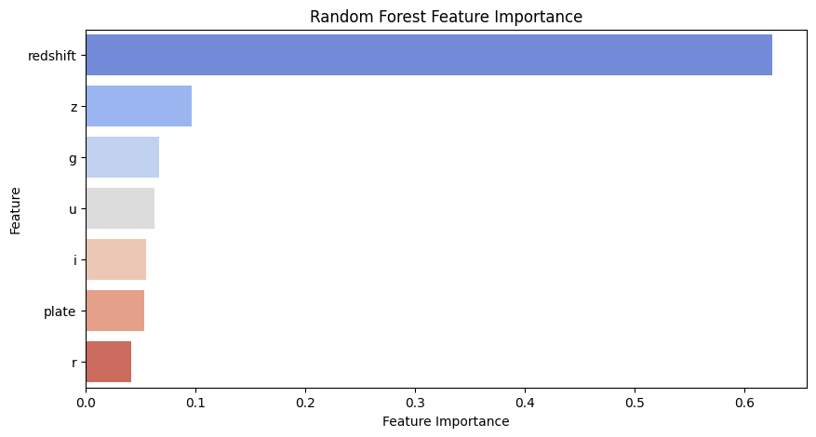
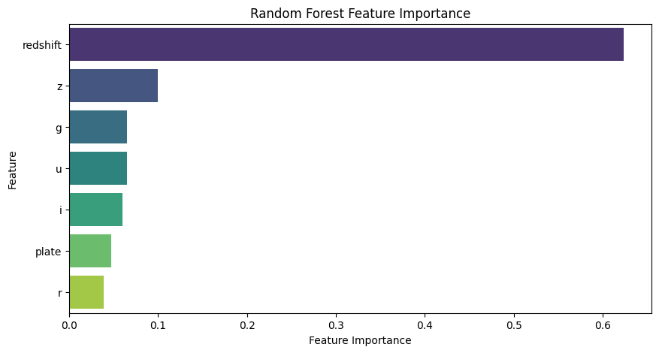
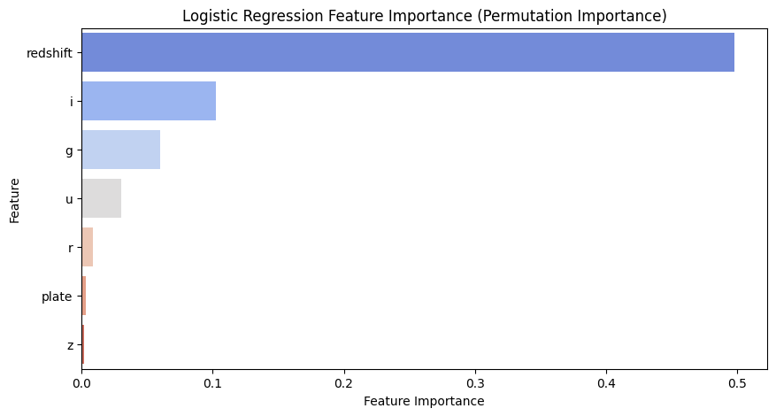
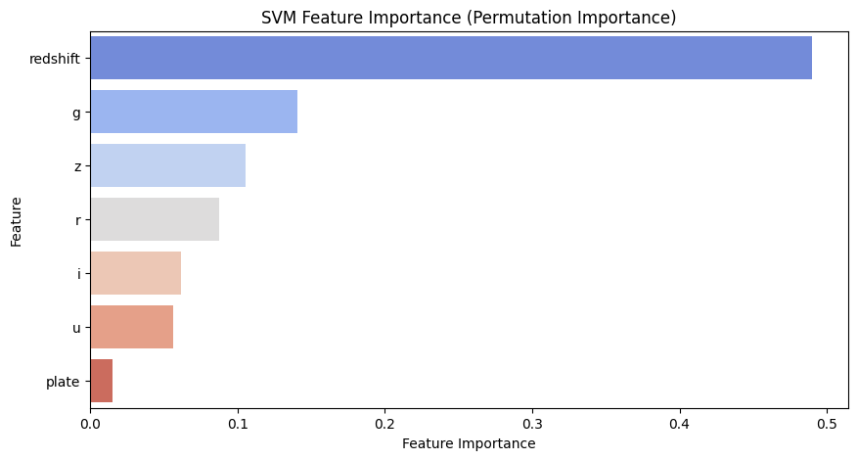
Feature Importance
As you can see redshift became by far the most important feature for all 3 of these models.
This makes a lot of sense since most stars generally have a lot less redshift than galaxies and quasars.
In random forest and SVM most of the light filters had around the same importance.
Plate did not end up being very important in any of the models.

Slide 20
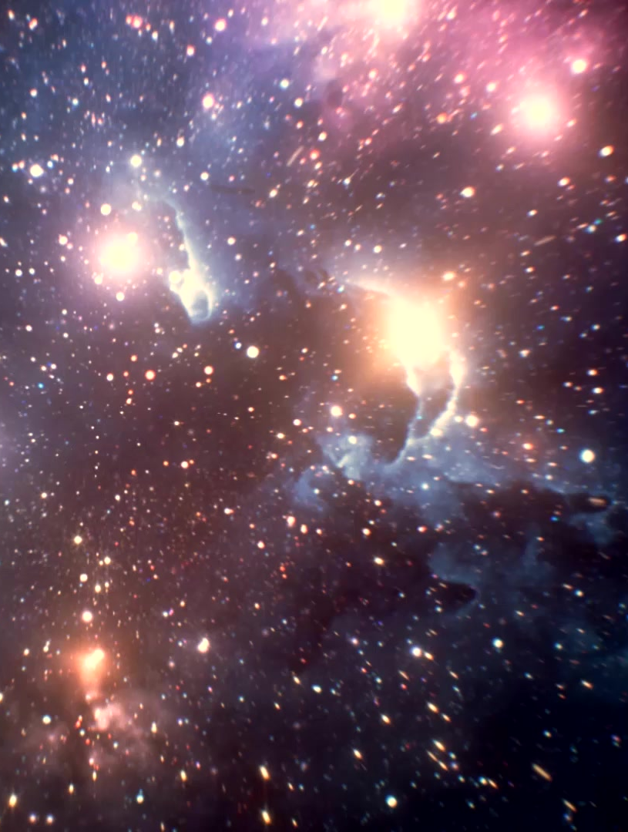
Why the models did so well
Redshift ended up being a very good predictor of class, entries with very low redshifts were very likely to be stars while entries with high redshifts were likely to be galaxies or quasars
From here the models could use the light filters effectively distinguish between galaxies and quasars
Had 10,000 data entries to work with, more data generally produces more accurate models to a certain extent.

Slide 21

Thank you for Listening, any Questions?

